Slide 1

IN THE NAME OF GOD
NMR Spectroscopy
Aref Honarparvaran
Master Student of Chemical Engineering
Supervisor: Dr Mehrnia
Advisor: Dr Pourasgharian Roudsari
Spring 1401

Slide 2
Introduction
Principles
Sample preparation
Analysis
Introduction
What is NMR and Why do we use it?
The difference between NMR and other analysis
  Mass spectroscopy (Example: C3H7Cl)
  FTIR (Many C….H vibrations)
  NMR (Is it ClCH2CH3 or H3CCHCH3 ???)
What is the principle of NMR?
Cl

Slide 3
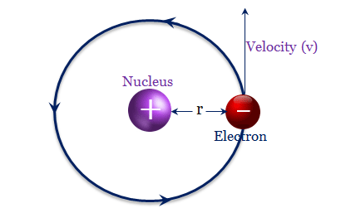

Introduction
Principles
Sample preparation
Analysis
Consider a hydrogen atom
Acts like:
B
Fig 1. Schematic of hydrogen atom and its similarity to magnet
Other atoms can be act like magnet like C, F and P (CNMR, FNMR, PNMR)
  Odd number of protons
  Odd number of Neutrons
  Both (Deuterium)
4

Slide 4

Introduction
Principles
Sample preparation
Analysis
I) Deshielded
magnet
magnet
B
Applied magnetic field
NMR
NMR
Fig 2. Magnet spinning inside magnetic field (Deshielded)
5

Slide 5












Introduction
Principles
Sample preparation
Analysis
II) Shielded
Applied magnetic field
magnet
B
Applied magnetic field
Local magnetic field
$$e^{−}$$
$$e^{−}$$
$$e^{−}$$
$$e^{−}$$
$$e^{−}$$
Effective magnetic field
$$e^{−}$$
$$e^{−}$$
$$e^{−}$$
$$e^{−}$$
$$e^{−}$$
$$e^{−}$$
$$e^{−}$$
NMR
Diamagnetic shield disturbs the magnet from rotating
Diamagnetic shielded
Fig 3. Magnet spinning inside magnetic field (Shielded)
6

Slide 6
Introduction
Principles
Sample preparation
Analysis
B effective= B Applied – B local
Deshielded
I) B effective = B Applied – 0
Shielded
II) B effective = B Applied – ( )
6

Slide 7







Introduction
Principles
Sample preparation
Analysis
magnet
magnet
rf radiation
E1
NMR
NMR
α-spin state
β-spin state
magnet
magnet
$$e^{−}$$
$$e^{−}$$
$$e^{−}$$
$$e^{−}$$
$$e^{−}$$
$$e^{−}$$
$$e^{−}$$
rf radiation
$$e^{−}$$
$$e^{−}$$
$$e^{−}$$
$$e^{−}$$
$$e^{−}$$
$$e^{−}$$
$$e^{−}$$
$$e^{−}$$
E2
$$e^{−}$$
$$e^{−}$$
$$e^{−}$$
$$e^{−}$$
$$e^{−}$$
$$e^{−}$$
$$e^{−}$$
$$e^{−}$$
NMR
>
NMR
$$e^{−}$$
β-spin state
E1
E2
Fig 5. Applying rf radiation for atom resonance
7

Slide 8
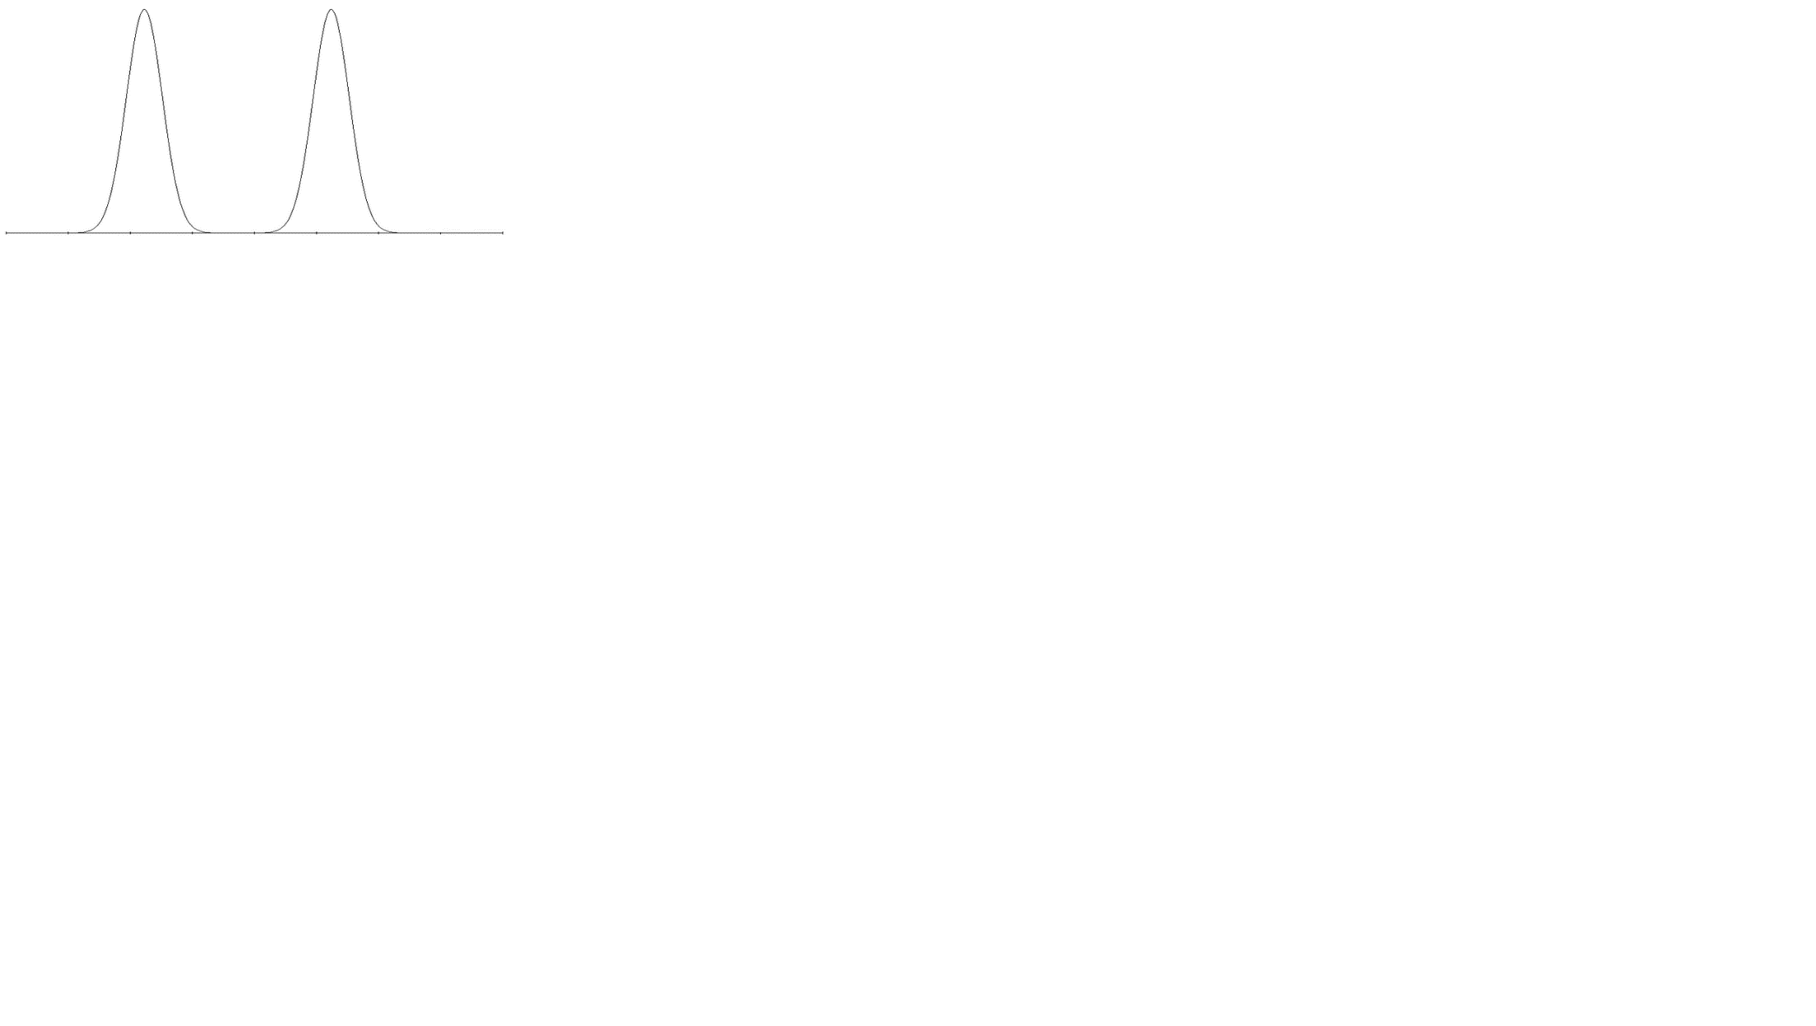
Introduction
Principles
Sample preparation
Analysis
Downfield Signal
Upfield Signal
Energy
0
E1
E2
(Deshielded)
(Shielded)
Fig 6. Energy required for shielded and deshielded atoms to resonate
9

Slide 9
Introduction
Principles
Sample preparation
Analysis
Shielded
B effective
E
Downfield
Deshielded
B effective
E
Upfield
8

Slide 10
Introduction
Principles
Sample preparation
Analysis
Example:ClCH2CH3
ClCH2CH3
ClCH2CH3
Deshielded
Shielded
Cl atom can pull the electrons adjacent to hydrogen towards itself due to its high electronegativity and H becomes deshielded.
This is what exactly happens to another H atom but it is less severe, So it becomes more shielded.
10

Slide 11
Introduction
Principles
Sample preparation
Analysis
Useful Solvents for NMR
CDCl3
DMSO-d6
D2O
Acetone-d6
11

Slide 12
Introduction
Principles
Sample preparation
Analysis
HNMR, PNMR, FNMR
5-10 mg sample in 0.5-0.7 solvent
CNMR
30-40 mg sample in 0.5-0.7 solvent
Samples must be dried as possible before dissolving in solvent (freeze drying method is helpful)
13

Slide 13
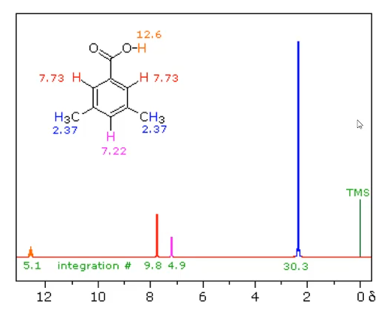
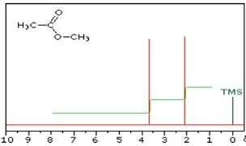
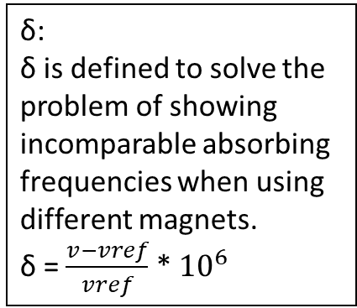
Materials &
Method
Result & Discussion
Analysis
Introduction
Conclusion
δ:
δ is defined to solve the problem of showing incomparable absorbing frequencies when using different magnets.
δ = $\frac{v−vref}{vref}$ * ${10}^{6}$
TMS (Tetramethylsilane) has been chosen as the reference material because its 12 protons are absorbed at equal frequency.
12

Slide 14
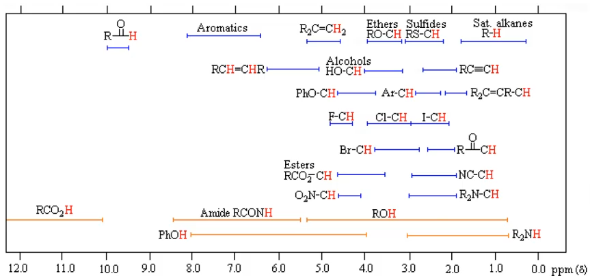
Materials &
Method
Result & Discussion
Analysis
Introduction
Conclusion
Analysis of HNMR
14

Slide 15


